Slide 1






Shoe Store Inventory Management System
Group Members: Python Frameworks:
Saad Ali Babar Tkinter (Front-end)
Awais Saleem MySql (Database)
Andleeb Ghazal Flask (Backend for main access)

Slide 2
Functionality
A shoe store management system with shoes stored against an ID.
User account registration and sign in
Admin/Store man Login & Log Out
Admin Panel
CURD (Create/Add, Update, Read/Search and Delete/Consume)
Add New Store Man
Store Man Panel
CURD (Create/Add, Update, Read/Search and Delete/Consume)

Slide 3
Project Feature Distribution
Awais Saleem
Login/Log Out Screen
Admin Panel Functionality and Design
Saad Ali Babar
Store Man Panel
Consume/Delete Product
Update Detail Product
Andleeb Ghazal
Save Product Detail
Update Product Detail

Slide 4
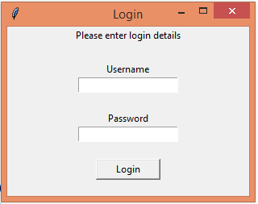
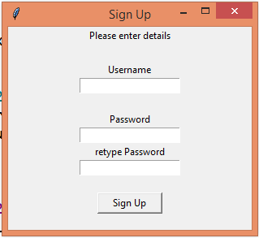
Login Screen Add Store Man

Slide 5
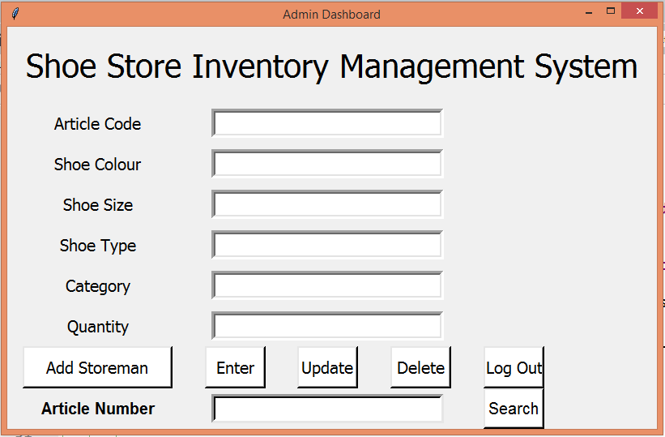
Admin Panel Dashboard/GUI Interface

Slide 6
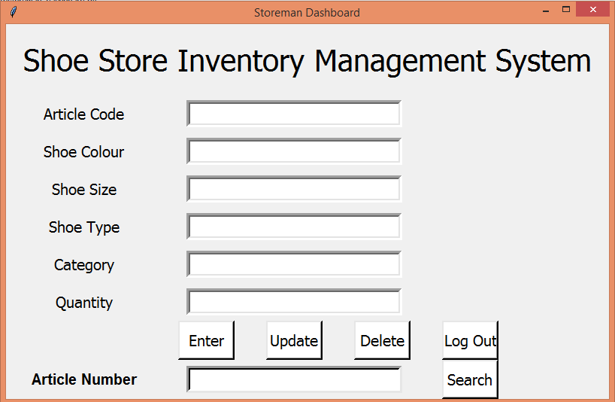
Store man Panel Dashboard/GUI Interface

Slide 7
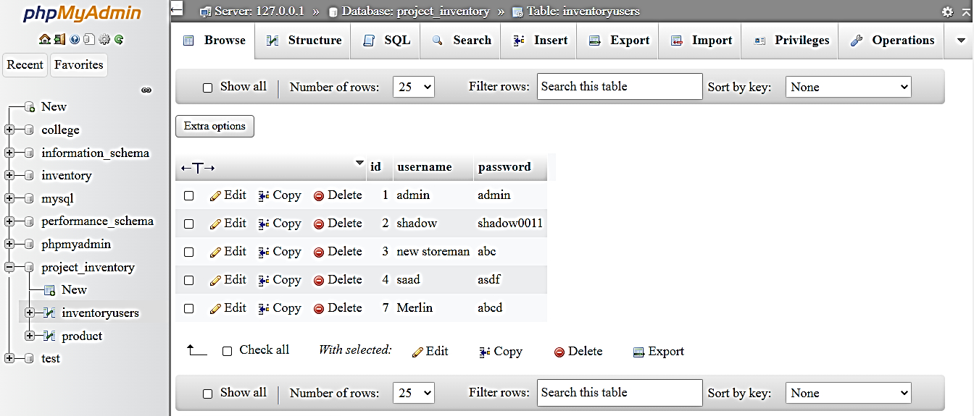
Database
Admin & Store Man Login/Password

Slide 8
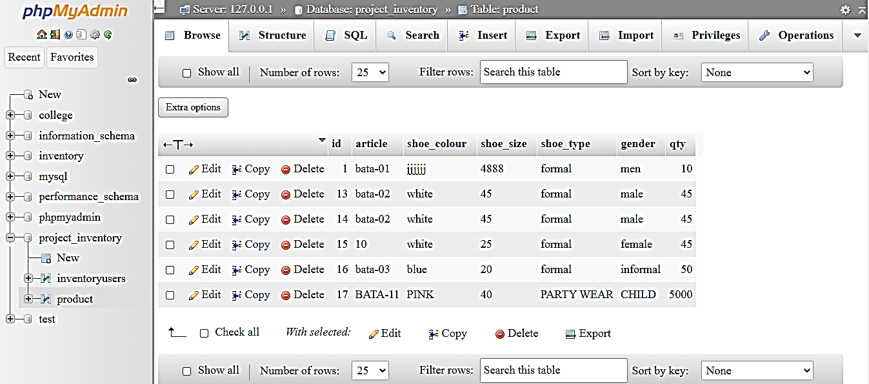
Database
Product Details

Slide 9
Thank you!

